Slide 1
Customer Support Chatbot With ML
PIP2001 University Project-II
Review-1
Batch Number: ISD-09
Under the Supervision of,
Prof.Likith S R
Professor / Associate Professor / Assistant Professor
School of Computer Science & Engineering
Presidency University
Roll Number | Student Name
20211ISD0018 | MADDIPATLA. ADHRSH
20211ISD0021 | K. VISHNU VARDHAN
20211ISD0031 | JATHIN .B.S
20211ISD0033 | CHANDAN.B.N
Name of the Program: ISD
Name of the HOD: PALLAVI R
Name of the Program Project Coordinator: Mr.Amarnath J.L & Dr. Jayanthi.K.
Name of the School Project Coordinator: Dr. Sampath A K ?Dr. Abdul Khadar A/ Mr. Md Zaiur

Slide 2
Introduction
The project focuses on developing an intelligent chatbot that can interpret customer queries and complaints, search a database for resolutions, and escalate issues to support staff if necessary. The chatbot will also update the database with new solutions based on interactions between support staff and customers with voice , ensuring that future similar queries can be handled autonomously. The goal is to reduce manual intervention while enhancing customer satisfaction.

Slide 3
Literature Review
1.Customer Service Chatbots: A Review
Authors: Adamopoulou, E., Moussiades, L.
Journal/Conference: Applied Sciences, 2020.
Summary: This paper provides a comprehensive review of chatbot applications in customer service, focusing on how NLP is applied to interpret user queries. The limitations of rule-based systems and the potential of machine learning-based chatbots are discussed.
Key Findings: The review highlights the challenges in accurately understanding customer intent and how self-learning chatbots can help.
2. A Survey on the Advances in Chatbots for Customer Service
Authors: J. Pereira, C. Diaz.
Journal/Conference: International Journal of Artificial Intelligence, 2019.
Summary: This paper discusses the evolution of chatbots and their integration into customer service. It emphasizes conversational agents using reinforcement learning and transfer learning for improving customer satisfaction.
Key Findings: Transfer learning can help chatbots quickly adapt to new types of customer queries without the need for vast amounts of retraining.

Slide 4
Literature Review
3.Deep Learning Approaches for Conversational AI: A Survey
Authors: Serban, I. V., et al.
Journal/Conference: ACM Computing Surveys, 2018.
Summary: The authors present a detailed survey of deep learning techniques used in conversational agents. The survey covers sequence-to-sequence models, attention mechanisms, and the role of transformers in advancing chatbot capabilities.
Key Findings: Modern deep learning architectures significantly improve intent recognition and response generation, allowing chatbots to better handle varied customer queries.
4. Learning to Chat with Customers: A Survey of Open-domain Chatbot Systems
Authors: L. Chen, D. Xu.
Journal/Conference: IEEE Access, 2020.
Summary: This survey explores the application of open-domain chatbots in customer service, examining how different machine learning models like BERT, GPT-2, and T5 can interpret and respond to natural language.
Key Findings: Hybrid approaches that combine retrieval-based and generative models offer the best results in customer service chatbots.

Slide 5
Literature Review
5.Automated Chatbot for Customer Support Using NLP
Authors: Kumar, A., Sethi, S.
Journal/Conference: International Journal of Advanced Research in Computer Science and Software Engineering, 2021.
Summary: The paper proposes an automated chatbot system that leverages NLP to handle customer queries. The system focuses on intent recognition and dynamic response generation.
Key Findings: The use of sentence embeddings helps improve the accuracy of retrieving previously solved issues for new customer queries.
6. Artificial Intelligence-Powered Chatbots in Customer Service: A Study on Adoption and Application
Authors: H. Xu, Z. Liu.
Journal/Conference: International Conference on Management of Data, 2019.
Summary: This research examines how AI-powered chatbots are being adopted by companies to improve customer service efficiency. It focuses on chatbots’ ability to reduce response time and learn from previous interactions.
Key Findings: The learning capacity of chatbots ensures better service delivery over time, and self-updating databases are critical for continuous improvement.

Slide 6
Literature Review
6.Entity Recognition and Intent Classification for Customer Service Chatbots
Authors: J. Devlin, M.-W. Chang.
Journal/Conference: Proceedings of the Association for Computational Linguistics (ACL), 2020.
Summary: This paper explores the application of BERT for entity recognition and intent classification in customer service chatbots. The authors show how pre-trained models can be fine-tuned for specific use cases, improving performance.
Key Findings: Fine-tuning BERT and other pre-trained models enables more accurate interpretation of customer queries and entities.
8. Reinforcement Learning for Conversational AI: Self-Learning Chatbots in Customer Support
Authors: K. Mnih, D. Silver.
Journal/Conference: Journal of Artificial Intelligence Research, 2019.
Summary: The study investigates the use of reinforcement learning (RL) in chatbot systems, where the chatbot learns to respond better over time by receiving feedback from interactions with users.
Key Findings: RL techniques allow chatbots to adapt to customer preferences and learn from failed conversations, improving the user experience.

Slide 7
Existing method Drawback
Chatbot for Customer Complaint Resolution and Knowledge Base Management, the existing methods often have several drawbacks, including:
Limited Understanding of Complex Queries: Many chatbots struggle to accurately comprehend complex customer queries, especially those that involve nuanced or technical issues. This often leads to incorrect or irrelevant responses, frustrating users.
Predefined Responses: Traditional chatbots rely heavily on predefined response trees. They lack the flexibility to adapt to unique or uncommon situations, resulting in canned responses that may not address specific customer concerns effectively.
Lack of Personalization: Existing systems often fail to personalize interactions based on previous customer history or preferences. This can lead to generic answers that do not adequately cater to individual needs, making the chatbot feel impersonal and less engaging.
Inability to Escalate: Some chatbots do not have an efficient escalation mechanism to transfer unresolved issues to human agents. This leads to delays in resolution when the chatbot reaches the limits of its capabilities.

Slide 8
Proposed Method
The chatbot system will:
Interpret customer complaints using NLP techniques.
Search the database for existing solutions to common queries.
Escalate unresolved or new issues to human support staff.
Update the database with new solutions based on conversations between the customer and support staff, ensuring continuous improvement.

Slide 9
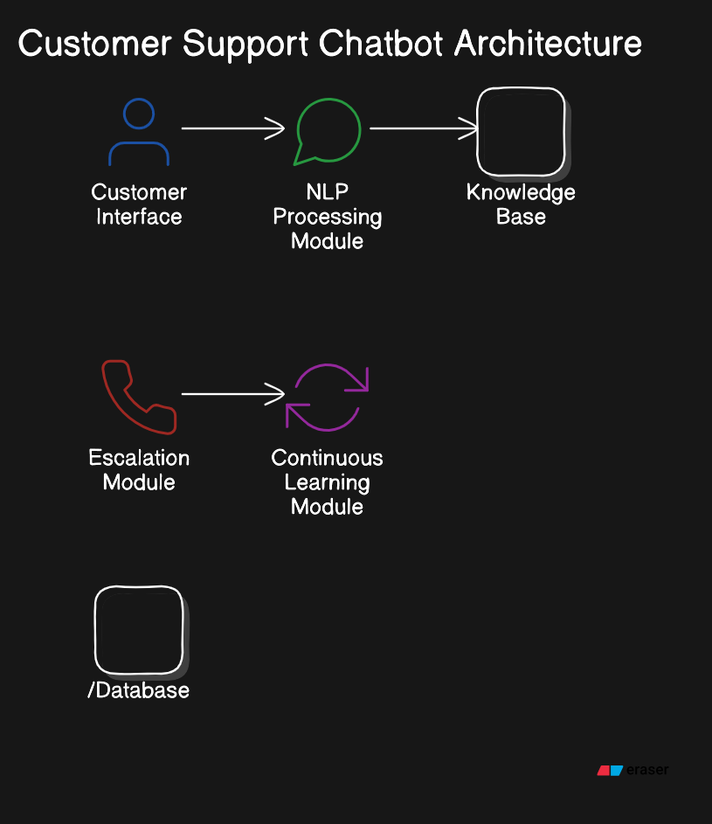
Architecture Diagram

Slide 10
Modules
Customer Interface (Top):
Place this at the top, representing where users input their complaints. Label it "Customer Interface.“
NLP Processing Module (Below Customer Interface):
Draw an arrow from the "Customer Interface" to a box labeled "NLP Processing Module." This represents the chatbot's ability to interpret and understand the user input.
Knowledge Base/Database (Middle):
Draw an arrow from the "NLP Processing Module" to a central box labeled "Knowledge Base/Database." This represents the chatbot searching for solutions in its database.
Escalation Module (Side of Knowledge Base):
Draw an arrow from the "Knowledge Base/Database" to a side box labeled "Escalation Module." This shows how unresolved queries are forwarded to human support agents.
Continuous Learning Module (Bottom):
Draw a final arrow from the "Escalation Module" to the "Continuous Learning Module" at the bottom. This module represents how the system updates the knowledge base with new solutions after human intervention.

Slide 11
Requriments
Hardware and Software Details
Hardware Requirements
Processor: Multi-core (e.g., Intel Xeon, AMD Ryzen)
RAM: Minimum 16 GB
Storage: SSD, at least 512 GB
Network: High-speed internet (100 Mbps or more)
Software Requirements
Operating System: Windows Server
Programming Languages:
Machine learning
Python
JavaScript (Optional)
NLP Libraries:
SpaCy
NLTK
Database:
MySQL or PostgreSQL

Slide 12
Objectives
Develop an AI-based chatbot that can handle customer complaints and queries autonomously.
Integrate a robust database search mechanism to retrieve resolutions efficiently.
Create an escalation system to hand over unresolved queries to support staff.
Implement a learning system that updates the database based on new solutions and improves over time.
Enhance customer satisfaction by reducing response time and manual intervention.

Slide 13
Methodology
Data Collection: Customer queries will be gathered to build a comprehensive knowledge base.
AI/NLP Integration: The chatbot will use NLP to interpret and understand customer queries.
Database Design: A structured database will store and retrieve solutions.
Support Staff Workflow: Unresolved or complex issues will be forwarded to support staff.
Continuous Learning: The chatbot will update the knowledge base with new information after staff resolves the issue.

Slide 14
Timeline of Project
Data Collection & Analysis: Week 1-2
Chatbot Design: Week 3-4
Database & Backend Integration: Week 5-6
Testing with Simulated Queries: Week 7-8
Final Integration & Evaluation: Week 9-10

Slide 15
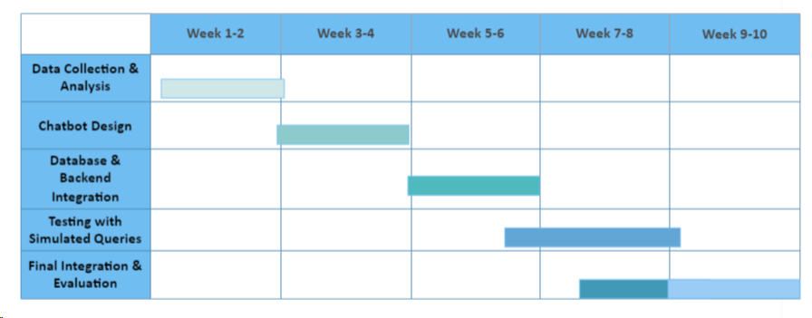
Ganchart

Slide 16
Expected Outcomes
Faster resolution of customer complaints and queries.
Reduced workload for support staff by automating common query resolution.
A continuously learning chatbot system that will evolve over time to handle new types of queries more effectively.

Slide 17
Conclusion
The chatbot system aims to revolutionize customer service by automating the resolution of common complaints, seamlessly integrating human support for unresolved issues, and ensuring continuous learning from each interaction. This project will enhance efficiency, improve customer satisfaction, and reduce the burden on support staff.

Slide 18
References
Adamopoulou, E., & Moussiades, L. (2020). An overview of chatbot technology. IFIP International Conference on Artificial Intelligence Applications and Innovations, 373-383.
Kumar, S., & Sharma, M. (2021). Artificial intelligence in customer service: A systematic literature review. Journal of Customer Service Management, 9(2), 123-134.
Radziwill, N. M., & Benton, M. C. (2017). Evaluating quality of chatbots and intelligent conversational agents. Journal of Quality Management and Business Innovation, 7(3), 67-79.
McTear, M. (2020). Conversational AI: Dialogue Systems, Conversational Agents, and Chatbots. Synthesis Lectures on Human Language Technologies, 13(1), 1-167.
Jurafsky, D., & Martin, J. H. (2019). Speech and Language Processing (3rd ed.). Pearson.
Vinyals, O., & Le, Q. V. (2015). A Neural Conversational Model. Proceedings of the International Conference on Machine Learning (ICML).

Slide 19
Thank You

